Slide 1



Predicting Rolex Watch Prices Using Machine Learning
Project By: Wael Mokhallalate
Mohamad Mourad
Youssof Khawaja

Slide 2
TABLE OF CONTENTS
01
02
03
04
09
Introduction
05
Model Training
Data Collection
06
Model Testing
Data Preprocessing
07
Model Evaluation
Model Selection
08
Deployment
Conclusion

Slide 3
Introduction
The main goal of this project is to predict the prices of Rolex watches based on various features such as Model, Case Material, Bracelet Material, Gender, Number of Jewels, and Year of Production.
Accurately predicting watch prices can assist buyers and sellers in the Rolex watch market to make informed decisions. It also highlights the role of machine learning in pricing models for high-value items.

Slide 4
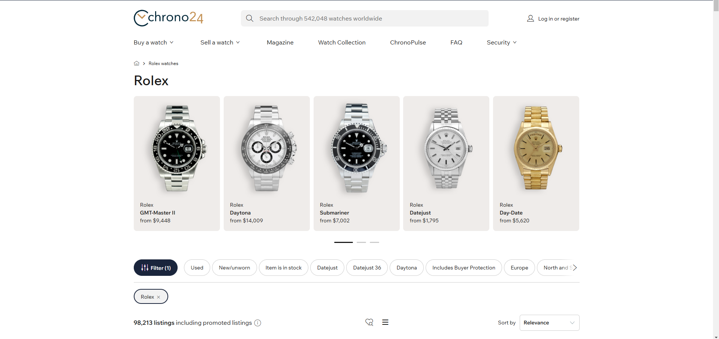
Data Collection
The dataset was created by scraping data from the Chrono24 website. We used Selenium, a powerful web scraping tool in python, to extract watch details and use as features like Model, Case Material, Bracelet Material, Gender, Number of Jewels, and Year of Production, along with the target variable Price.

Slide 5

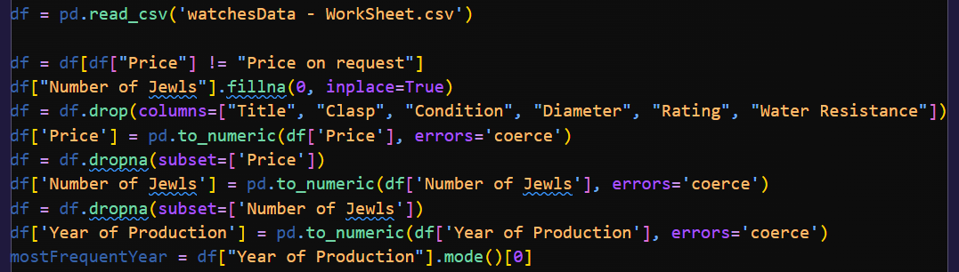
Data Preprocessing
First, we imported the data and inspected it for null values.
Next, we handle missing values by imputing or removing records as required:
For Number of Jewels, missing values were replaced with 0.
For Year of Production, missing values were replaced with the most frequent year.
Rows with Price = "Price on request" were dropped.
Dropped irrelevant columns: Title, Clasp, Condition, Diameter, Rating, and Water Resistance were removed as they were not critical for prediction.

Slide 6
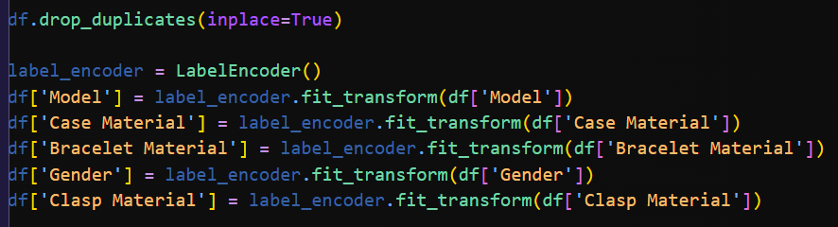
Data Preprocessing
Converted categorical variables into numeric values using Label Encoder:
Categorical columns like Model, Case Material, Bracelet Material, Gender, and Clasp Material were encoded into numbers.
Finally, we checked the dataset for duplicates and dropped any redundant records.

Slide 7
Model Selection
Regression Model:
We selected a regression model because the target variable Price is continuous.
Machine Learning Algorithm: We chose the K-Nearest Neighbors Regressor (KNN) for these reasons:
Simplicity and ease of interpretation.
Linear Regression is a parametric model and may underperform if the data is not well-suited to a linear fit.
Watch prices are influenced by diverse factors (e.g., brand, materials, year, and features) that likely interact in non-linear ways.
KNN is better equipped to handle such diverse and complex data.

Slide 8
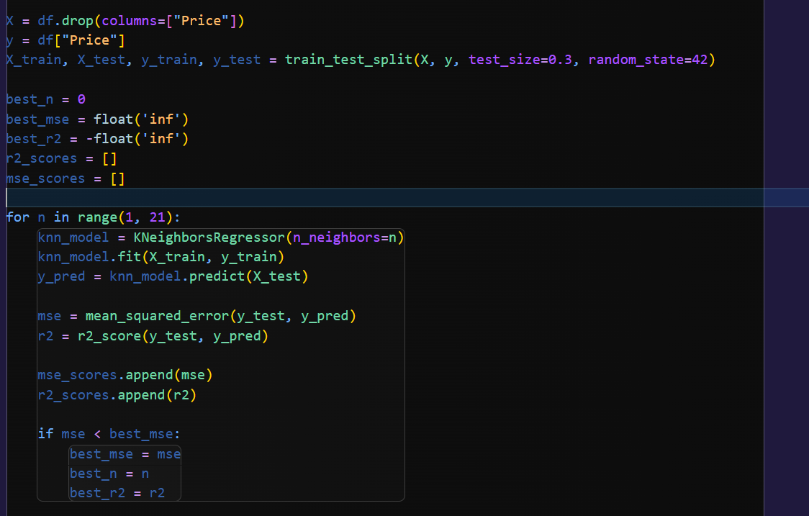
Model Training
Split the Data:
The dataset was divided into training (70%) and testing (30%) sets.
We tested different values of n_neighbors ranging from 1 to 20 to find the best-performing model.
The optimal value of n_neighbors was selected based on the lowest Mean Squared Error (MSE).

Slide 9
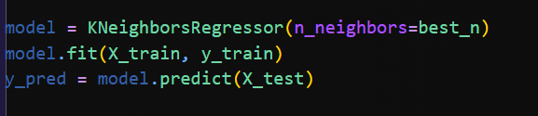
Model Testing
The KNN regressor was evaluated on the test set using the optimal value of n_neighbors .

Slide 10
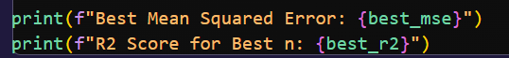
Model Evaluation
The model was evaluated using the following metrics:
Mean Squared Error (MSE): Measures the average squared difference between predicted and actual values.
R2 Score: Indicates the proportion of variance in the target variable that the model explains.

Slide 11
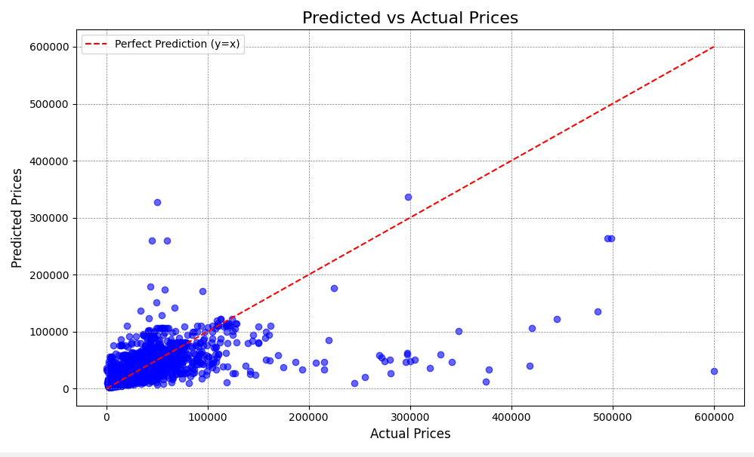
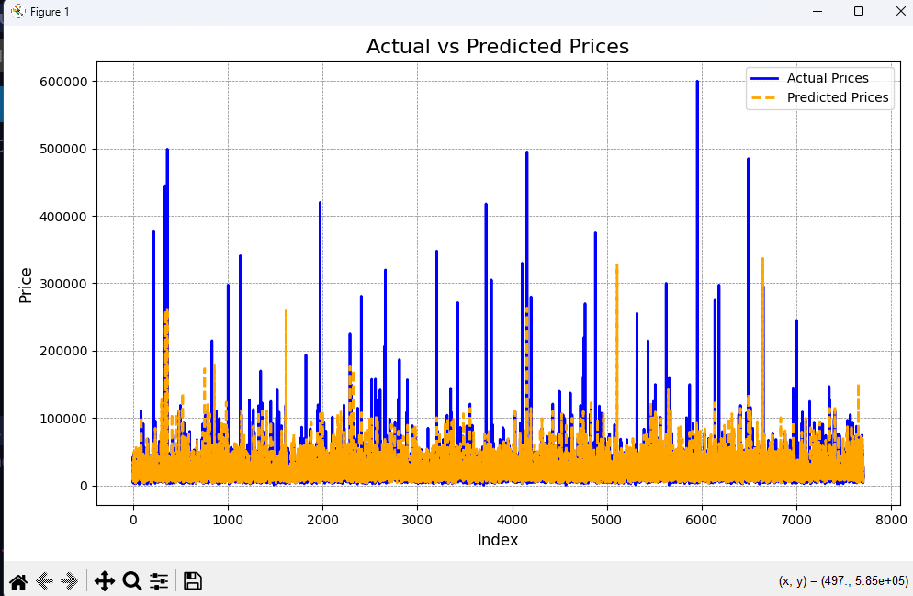
Model Evaluation

Slide 12
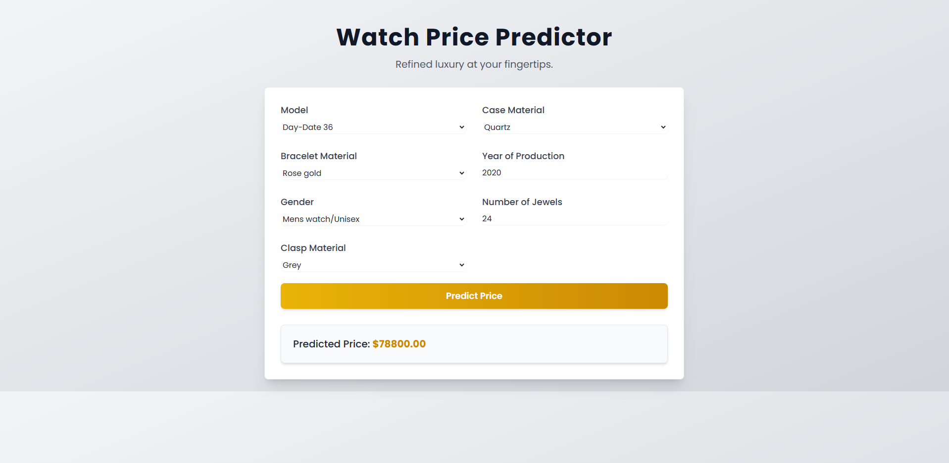
Deployment
Hosting the Model:
After training and testing the K-Nearest Neighbors model, we deployed it on the internet to allow users to test the model interactively.
The hosting was done at https://rolexprices.netlify.app/, making it accessible for users to input features and get predicted watch prices in real-time.

Slide 13
Conclusion
The K-Nearest Neighbors algorithm was applied to predict watch prices based on several features, achieving the following performance metrics:
Mean Squared Error (MSE): 445,478,471.06
R² Score: 0.41
Performance Analysis:
The R² score indicates that the model explains 41% of the variance in watch prices, leaving significant room for improvement.
The relatively high MSE suggests that the model struggles to accurately predict prices, likely due to the complexity or variability in the data.
Key Challenges:
High Variance in Prices: The dataset might contain a wide range of price values, making predictions harder.
Feature Importance: Some features may not contribute significantly to price prediction, or important features could be missing.
Algorithm Limitation: KNN may not perform well with datasets containing large price disparities or noise.

Slide 14
Future Improvements
Try Advanced Algorithms: Experiment with models like Random Forest Regressor or Gradient Boosting, which might better capture the complex relationships in the data.
Feature Engineering: Investigate additional features or transformations (e.g., logarithmic scaling for prices) to enhance the model.
While the model provides a baseline understanding, further work is needed to achieve higher predictive accuracy and explainability. This project offers a strong foundation for exploring advanced techniques in regression analysis.

Slide 15
THANK YOU
for listening!!

